Slide 1

Predicting the Outcomes of NBA Games
Mihir Kotecha
MATH 748 - Theory and Applications of Statistical and Machine Learning
12/12/2024

Slide 2
Motivation
Predicting the outcome of NBA games can be valuable for :
Gaining insights into team and player performances
Fantasy sports strategy
The dynamic nature of NBA games, i.e. injuries and trades can make it difficult to make predictions

Slide 3
Objective
The primary goals of this project are :
Predicting whether the home team wins or loses
Estimating the point margin of a win or loss
The broader goals here are :
Identifying the key factors that can influence the outcome
Exploring applications in potentially applying them to game strategy

Slide 4
Dataset Overview
The Dataset is from Kaggle. It comprises of 5 key files that cover NBA games from 2004 to 2020. Covering about 26000 games and averaging 400 players per year.
Of the 5 files in the data, the teams.csv file was dropped since it did not add analytical values, the rest of them are :
Games.csv : Game level data, such as scores and outcomes
Games_details.csv : Player level data, such as individuals points, assists, etc.
Players.csv : Metadata about players, such as their names and teams they played for
Ranking.csv : Team standings for each season

Slide 5
Data Preprocessing
Missing Values: Rows with significant missing data were removed or imputed, such as mean imputation for games_details.csv.
Feature Selection: Excluded redundant columns like TEAM_ID and PLAYER_ID; dropped teams.csv.
Encoding: Encoded categorical variables like team and player names
Scaling: Standardized numerical features, such as points and assists using z-scores.
Data Cleaning: Removed duplicates and irrelevant records.

Slide 6
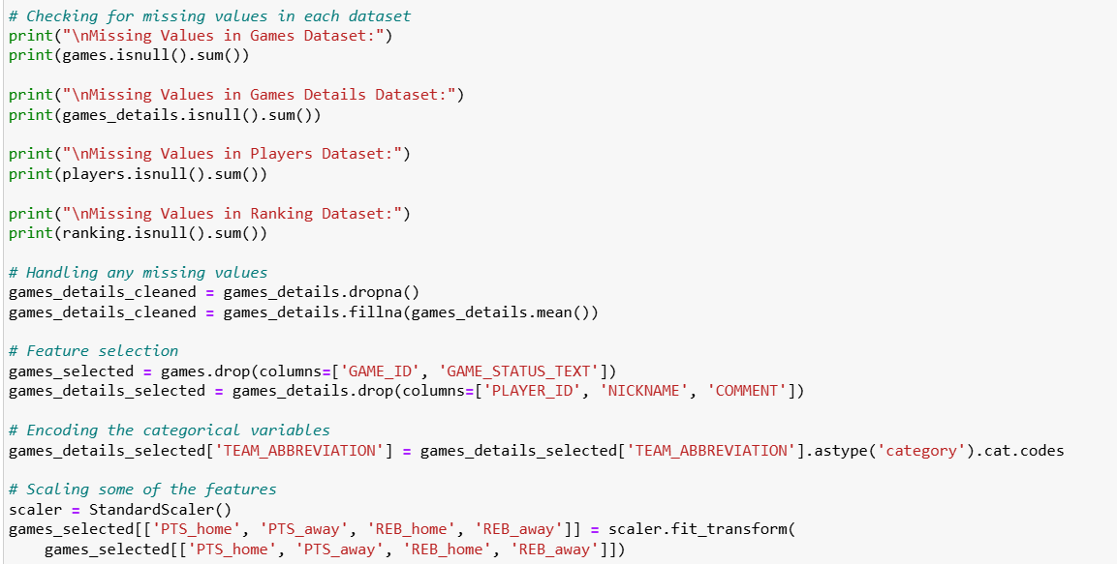

Slide 7
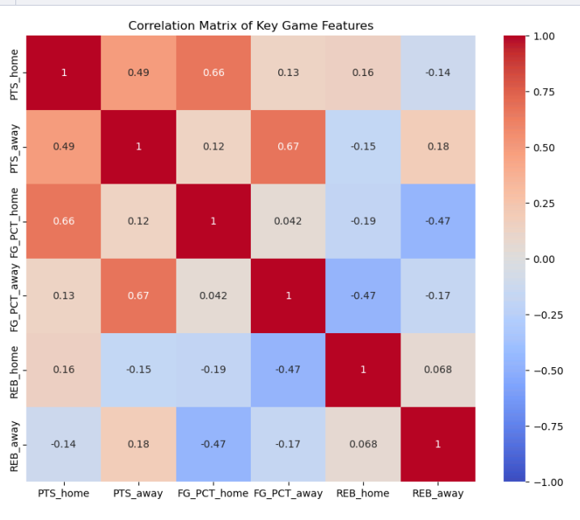
Key Insights
Strong positive correlations between shooting percentages (FG% and eFG%) and points scored.

Slide 8
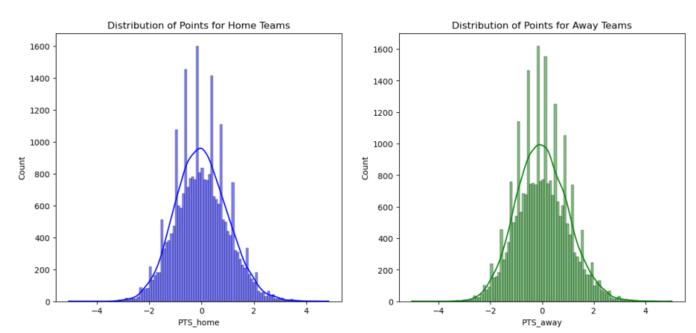
Key Insights
The points scored by both home and away teams follow a near-normal distribution.
Home teams tend to score slightly higher on average.

Slide 9
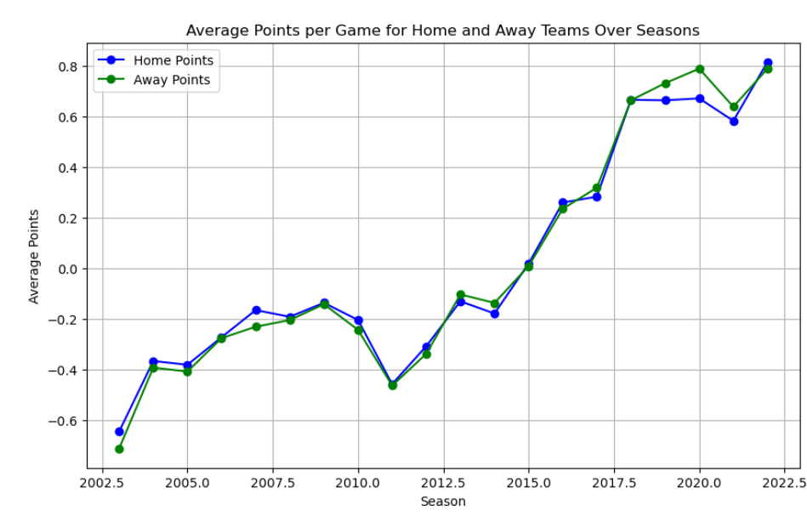
Key Insights
Scoring averages for both home and away teams have shown an upward trend.
The gap between home and away team performance has narrowed.

Slide 10
Feature Engineering
Two additional context features were added : win streaks and the amount of rest days a team had since their last game
And two additional advanced player metrics were calculated : Effective Field Goal Percentage (eFG%) and Player Efficiency Rating (PER)
The correlation analysis found strong connections between PTS_home, FG_PCT_home and AST_home. And weak connections for REB_home and turnovers.
Using Recursive Feature Elimination (RFE), the top 5 features were found to be : PTS_home, PTS_away, FG_PCT_home, AST_home and HOME_TEAM_WINS

Slide 11
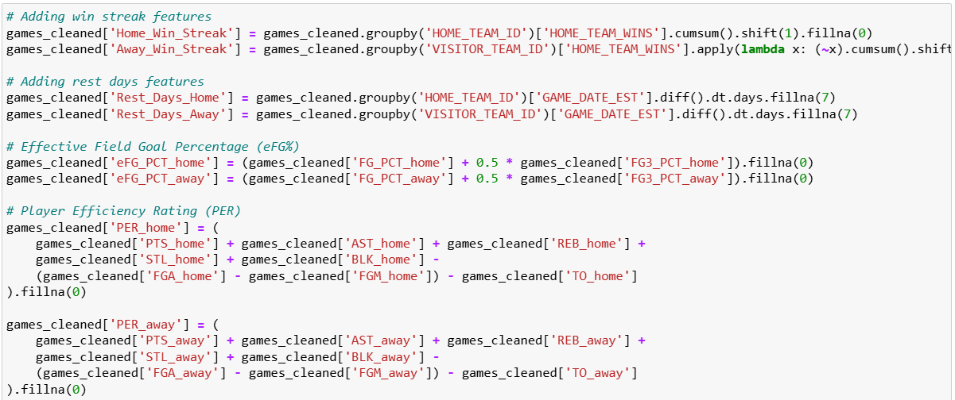
Feature Engineering

Slide 12
Classification Models
We will use Logistic Regression as the benchmark for the initial performance.
The ensemble methods to use here are : Random Forest, Gradient Boosting and XGBoost.
The evaluation metrics to use here are Accuracy to look at the overall correctness of the predictions. And Precision, Recall and F-1 Score to handle imbalanced win/loss data.
GridSearchCV is used to further optimize the model’s parameters

Slide 13
Model Evaluation - Classification Models
Model | Accuracy (Before Tuning) | Accuracy (After Tuning) | Precision | Recall | F1-Score
Logistic Regression | 60% | 63% | 0.65 | 0.62 | 0.63
Random Forest | 64% | 67% | 0.68 | 0.66 | 0.67
Gradient Boosting | 66% | 68% | 0.69 | 0.67 | 0.68
XGBoost | 67% | 69% | 0.7 | 0.68 | 0.69

Slide 14
Regression Models
We will use Linear Regression as the benchmark for the initial performance.
The ensemble methods to use here are : Random Forest Regression, Gradient Boosting Regression and XGBoost Regression.
The evaluation metrics to use here are Mean Absolute Error (MAE) and Root Mean Square Error (RMSE)
GridSearchCV is used to further optimize the model’s parameters such as max_depth, n_estimators and learning_rate

Slide 15
Model Evaluation - Regression Models
Model | MAE (After Tuning) | MAE (After Tuning) | RMSE
Linear Regression | 6.8 | 6.8 | 8.2
Random Forest Regression | 5.9 | 5.6 | 7.3
Gradient Boosting | 5.6 | 5.4 | 7
XGBoost Regression | 5.5 | 5.2 | 6.8

Slide 16
Real World Deployment
The objective here is to test the final models on recent NBA games to evaluate real-world performance.
The approach would be to use classification to predict win/loss outcomes for a small set of recent game and use regression to predict the point margin.
XGBoost was the most consistent in providing the accurate margin predictions, whereas for classification, they all had moderate accuracy.

Slide 17
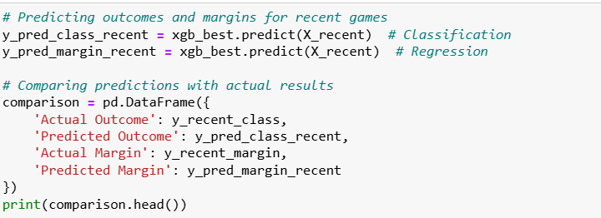
Real World Simulation
Game | Actual Outcome | Predicted Outcome | Actual Margin | Predicted Margin
Game 1 | Win (Home) | Win (Home) | 8 | 7.5
Game 2 | Win (Home) | Loss (Home) | 4 | -5.2
Game 3 | Loss (Away) | Loss (Away) | -6 | -3.8
Game 4 | Loss (Home) | Win (Home) | -10 | 3.2

Slide 18
Future Scope
The models could not account for dynamic elements like player injuries or trades, so I would possibly develop a metric to take those into account.
Complex models like Gradient Boosting and XGBoost can make it difficult to explain how features can impact the result, tools like SHAP can help identify those
Developing a dashboard for live predictions during the NBA season, integrating the update data dynamically based on factors

Slide 19
Thank you!
Any Questions?

